Slide 1
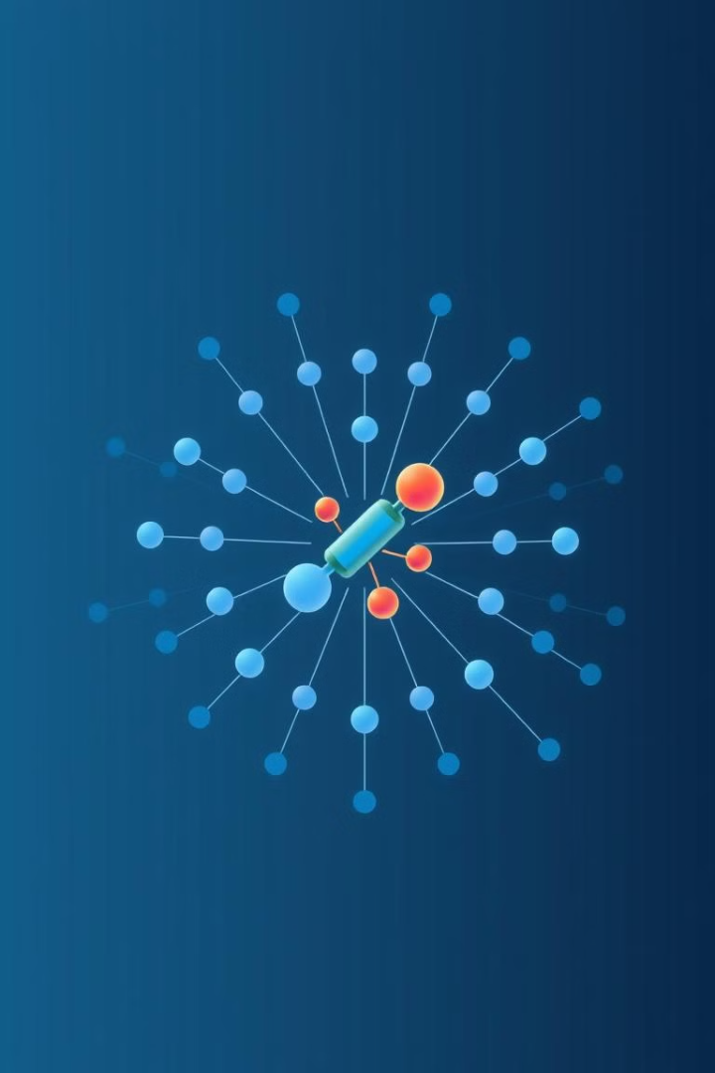
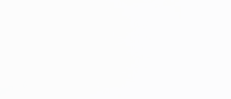

Drug Toxicity Prediction using Graph Neural Networks
by Saranya Pal

Slide 2

A brief summary:-
This project explores the potential of Graph Neural Networks (GNNs) for predicting the toxicity of drug molecules. The study investigates different embedding strategies and GNN architectures to determine the most effective combination for accurate and reliable toxicity prediction.

Slide 3

Introduction:-
1
Importance of Drug Safety
2
Challenges in Traditional Testing
Drugs save lives, but some may be too toxic for safe human use. Extensive testing is required to determine toxicity, which is a time-consuming process
Conventional toxicity assessment involves testing on large populations, monitoring side effects, and conducting chemical analyses, leading to delays in drug discovery.
3
Objective
4
ML to the rescue !!
This study aims to determine drug toxicity by using computational methods as an alternative to traditional lab tests, particularly Graph Neural Network architectures
Machine learning, especially Graph Neural Networks (GNNs), is leveraged for toxicity classification, offering an efficient solution for this complex problem, saving time and resources
5
The challenge
6
Molecules To Features
We only have the drugs (represented as SMILES code) and it’s toxicity label (0 or 1). Absence of any feature vector makes the classification challenging
We begin by extracting feature vectors from these SMILES code itself!! After that, GNNs are used to learn and classify toxicity of these drugs

Slide 4

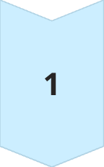
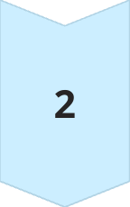
Why GNNs?
Standard ML and DL methods fail
It has been shown that using standard ML and DL models for graph datasets like this always performs worse than using GNNs
Incorporate the structure
The reason behind this is that GNN architectures can incorporate the complex architecture of graph data which is not possible with traditional ML and DL models.

Slide 5
The Dataset

Slide 6
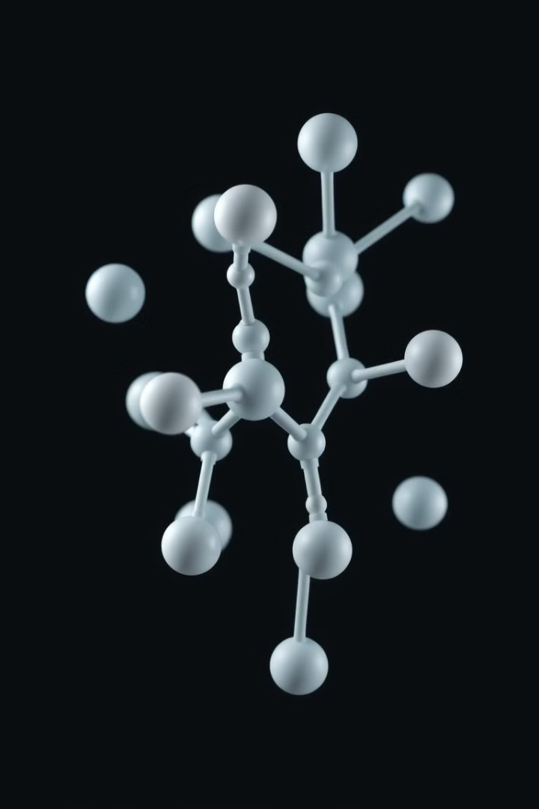
The ClinTox Dataset
The ClinTox dataset, part of the MoleculeNet collection, is a valuable resource for drug toxicity research. This dataset contains 1,480 drug compounds, each represented as a graph structure, with atoms as nodes and bonds as edges. The dataset includes two main classification tasks:
1
Clinical Toxicity
2
FDA Approval Status
Classifies drugs as either toxic or non-toxic, providing insights into potential adverse effects on human health.
Labels drugs as either approved or not approved by the Food and Drug Administration (FDA), reflecting regulatory decisions based on safety and efficacy.
NOTE:-
Among the 1480 drugs, there are 18 drugs that are toxic but still approved by FDA
But there are no such drugs that are non-toxic, still NOT approved by FDA

Slide 7
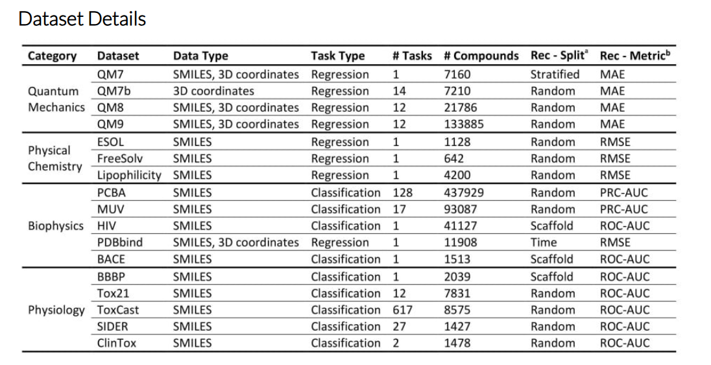

Slide 8
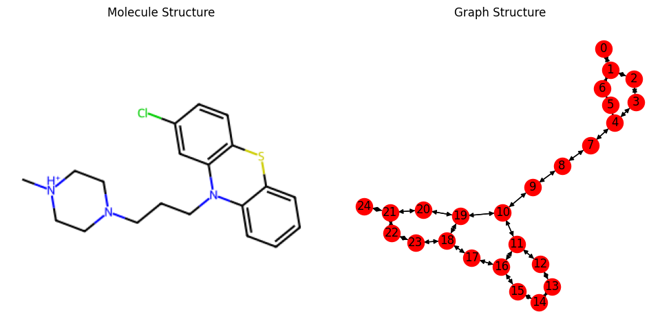
C[NH+]1CCN(CC1)CCCN2c3ccccc3Sc4c2cc(cc4)Cl

Slide 9
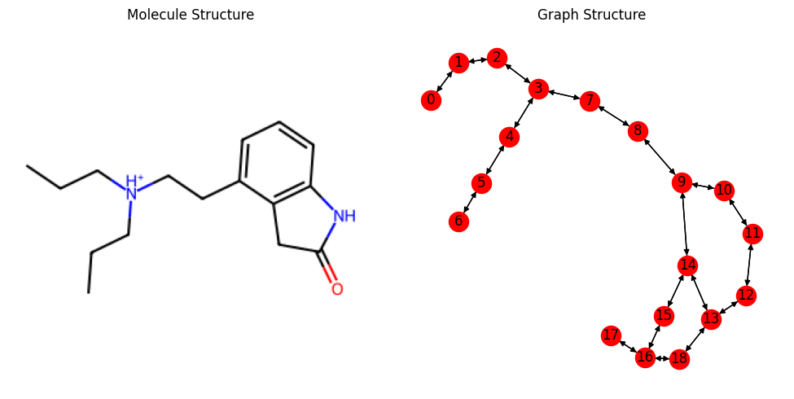
CCC[NH+](CCC)CCc1cccc2c1CC(=O)N2

Slide 10
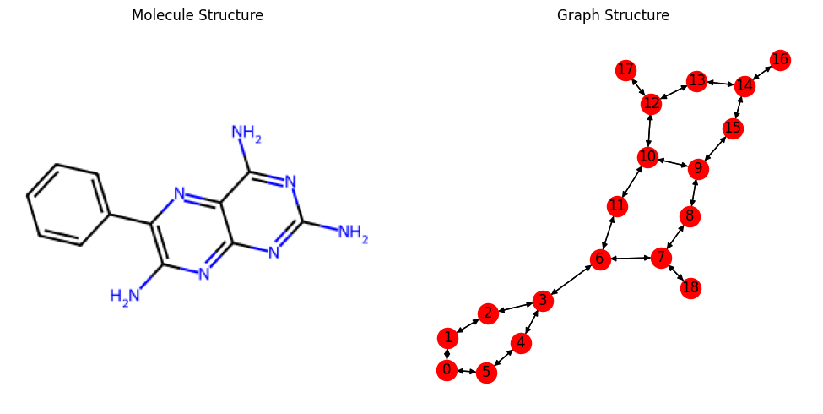
c1ccc(cc1)c2c(nc3c(n2)c(nc(n3)N)N)N

Slide 11

Molecular Representation and Features
Apart from the SMILES code (represented as Graphs), the Clintox dataset also has a set of 9 features. Every atom of a particular molecule/drug possesses a set of nine features. These features include:-
Atomic Number
Chirality
Formal Charge
Van der Waals Radius
Hybridization
Number of Hydrogens
Is_Aromatic
Degree
Implicit Valence

Slide 12
The Challenges With the Data
Insufficient Data
These 9 features are often insufficient, and leads to poor classification of toxicity. There is a clear requirement of encoding the Graph and extracting more features from the structure of the Graph
Class Imbalance
Very few of the 1480 molecules are toxic, precisely only 112. All the remaining are non-toxic. Thus, we need to pay more attention to the minority class and classify them correctly

Slide 13
Converting Graph to Feature Vectors

Slide 14
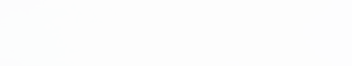
Embedding Strategies
This study explores three distinct embedding strategies, each with its own strengths and contributions, to capture different aspects of molecular structure and properties. These strategies are:
x Features (9 dim per atom)
Node2Vec (64 dim per atom)
Graph2Vec (64 dim per graph)
This is the same 9 features that was provided in the Clintox dataset. These are 9 features per atom. So, if a molecule has n atoms, the dimension of x is (n,9)
Node2Vec focuses on local neighborhoods within the molecule, learning low-dimensional representations of atoms based on their connections and relationships within the graph. So, for a molecule with n atoms, the dimension will be (n,64)
Graph2Vec takes a global perspective, capturing the overall structure of the molecule by generating a vector representation that summarizes the entire graph. Thus, a certain molecule will have dimension as (1, 64) irrespective of the no. of atoms present in it

Slide 15
Embedding Strategies
In a particular molecule, let us assume for now that the no. of atoms (represented as nodes) present be n = 5

Slide 16

Embedding Strategies
In a particular molecule, let us assume for now that the no. of atoms (represented as nodes) present be n = 5
1
2
3
4
5
x =
1 | 2 | 3 | 4 | 5 | 6 | 7 | 8 | 9

Slide 17
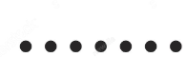
Concatenate the Embeddings
We first repeat the embeddings n times of the Graph2Vec (1, 64) along axis=0 to get the dimension (n,64)
Graph2Vec Representation:- (n = 5)
0.16 | -0.48 | 1.25 | 0.18 | 0.74
0.35 | -1.06

Slide 18
Concatenate the Embeddings
We first repeat the embeddings n times of the Graph2Vec (1, 64) along axis=0 to get the dimension (n,64)
Graph2Vec Representation:- (n = 5)
0.16 | -0.48 | 1.25 | 0.18 | 0.74
0.35 | -1.06
1
2
3
4
5
0.16 | -0.48 | 1.25 | 0.18 | 0.74
0.35 | -1.06
graph2vec =
0.16 | -0.48 | 1.25 | 0.18 | 0.74
0.35 | -1.06
0.16 | -0.48 | 1.25 | 0.18 | 0.74
0.35 | -1.06
0.16 | -0.48 | 1.25 | 0.18 | 0.74
0.35 | -1.06
1 | 2 | 3 | 4 | 5
63 | 64
This matrix is for a single molecule/graph only

Slide 19
Concatenate the Embeddings
In case of Node2Vec which provides embeddings for every Node/atom, we directly get (n,64) feature matrix
Node2Vec Representation:- (n = 5)
0.17 | -1.32 | -1.25 | 0.88 | 0.41
0.35 | 0.81
1
2
3
4
5
-0.35 | -0.14 | 1.01 | -1.21 | -0.01
0.70 | -1.00
node2vec =
-1.81 | -0.48 | 1.25 | -0.73 | 0.74
0.58 | 0.06
0.01 | -0.48 | 0.05 | 0.18 | 0.89
0.35 | -1.06
-1.57 | 0.85 | -1.05 | -0.78 | 0.50
0.03 | 0.57
1 | 2 | 3 | 4 | 5
63 | 64
Notice that the embeddings across axis=1 need not be same this time like the previous one

Slide 20
Concatenate the Embeddings
Finally we concatenate the embeddings from x, node2vec and graph2vec together to get a matrix of (n,137) for every molecule
Final Embeddings:- (n = 5)
0.17 | -0.02 | 0.11 | 0.88 | 0.41
0.35 | 0.81
1
2
3
4
5
-0.11 | -0.14 | -0.01 | -1.21 | -0.41
0.77 | 0.22
-1.81 | -0.97 | 0.25 | -0.91 | 0.74
-0.11 | -0.38
-1.25 | 0.33 | 0.05 | 0.18 | 0.22
0.35 | -1.06
-1.57 | 0.04 | -1.05 | -1.07 | 0.50
-1.03 | 0.57
1 | 2 | 3 | 4 | 5
136 | 137
Notice that the embeddings across axis=1 need not be same this time like the previous one

Slide 21
Concatenate the Embeddings
We have used 7 different subarrays from the previous final concatenated embeddings:-
x only (n, 9)
Node2Vec only (n, 64)
Graph2Vec only (n, 64)
(x + Node2Vec) (n, 73)
(x +Graph2Vec) (n, 73)
(Node2Vec + Graph2Vec) (n, 128)
(x + Node2Vec + Graph2Vec) (n, 137)

Slide 22
Using GNN architectures

Slide 23
GNN Architectures
Types of Architectures
We have used 6 different types of GNN architectures and built 6 different models for every of the 7 embedding methods as discussed previously
Class Imbalance
As discussed earlier, Clintox dataset is a highly imbalanced dataset. So, to incorporate that into our model, we have trained 6 of our 7 models by adjusting the class weights
Pooling and Final Layers
3
Finally, after the GNN layers, we use Max Pooling as well as Avg Pooling to convert the matrix into a vector of dim (1, 137). Then, we classify our molecule after passing the vector from 2 linear layers.

Slide 24
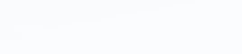
Model Architectures Used
1
Simple GCN
2
Simple GCN with Imbalance Handling
Graph Convolutional Network (GCN) utilizes convolution-like operations on the graph structure to learn representations of nodes, capturing local interactions between atoms.
This GCN model incorporates techniques to address the class imbalance problem in the dataset. This class imbalance is adjusted by class weights which was incorporated in the loss function during model training.
3
GAT with Imbalance Handling
4
Transformers with Imbalance Handling
Graph Attention Network (GAT) uses attention mechanisms to learn weights for different connections in the graph, allowing the model to focus on the most informative interactions.
Transformers apply self-attention mechanisms to learn relationships between nodes in the graph, capturing long-range dependencies and improving performance for complex molecular structures.
5
SAGEConv with Imbalance Handling
6
ResGatedConv with Imbalance Handling
SAGEConv (GraphSAGE) is a scalable GNN architecture that aggregates information from neighboring nodes to learn representations, making it suitable for large-scale datasets.
ResGatedConv combines residual connections with gated activation units to learn representations, improving model performance by alleviating vanishing gradient problems.

Slide 25
Model Evaluation and Results

Slide 26
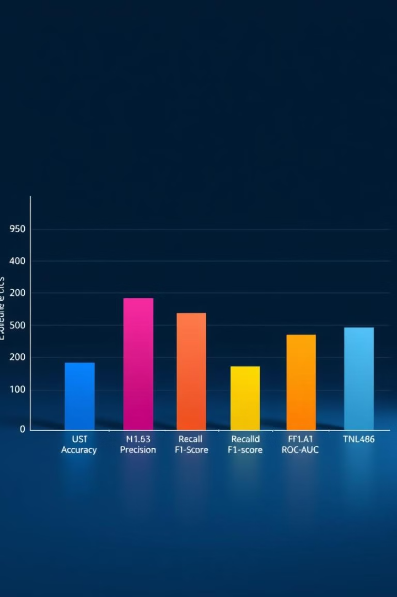
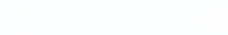
Model Evaluation Metrics
The performance of different GNN configurations is evaluated across five key metrics: accuracy, precision, recall, F1-score, and ROC-AUC. For imbalanced datasets like Clintox, accuracy is not always a good metric. Stating all drugs are non-toxic will still yield >90% accuracy. ROC-AUC score is a good metric in such cases.
Accuracy
Overall correct predictions
Precision
Proportion of correctly predicted positive instances
Recall
Proportion of correctly predicted positive instances out of all actual positive instances
F1-score
Harmonic mean of precision and recall, balancing both metrics
ROC-AUC
Area under the Receiver Operating Characteristic curve, measuring the model's ability to distinguish between classes

Slide 27
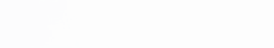
Results and Analysis
1. Accuracy :-

Slide 28
Results and Analysis
2. Precision :-

Slide 29
Results and Analysis
3. Recall :-

Slide 30
Results and Analysis
4. F1-score :-

Slide 31
Results and Analysis
An ROC-AUC score of 0.5 indicates no predictive performance
5. ROC-AUC score :-

Slide 32
Conclusion

Slide 33
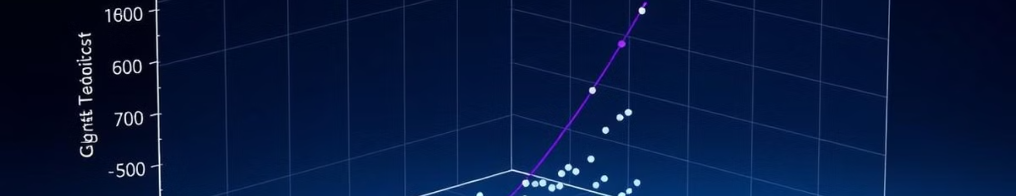
Conclusion
*We should not consider models with accuracy 0.91. So, 0.79 is highest
This study demonstrates the effectiveness of Graph Neural Networks for predicting drug toxicity, leveraging the power of graph representation and embedding strategies. By exploring various GNN architectures and embedding methods, we observe that GCN with Class Imbalance achieve the highest ROC-AUC score of 0.63, by using the embedding as (x + Node2Vec). But this is at the cost of a lower accuracy of 0.71
The next best model is the Tranformers architecture with Class Imbalance. It yields an ROC-AUC score of 0.58, and achieved a higher accuracy of 0.79* This result was achieved again when (x + Node2Vec) was used as the embedding
Among the embedding methods, (x + Node2Vec) consistently performed the best and yielded the best results both in terms of Accuracy and ROC-AUC score.

Slide 34
Future Work

Slide 35
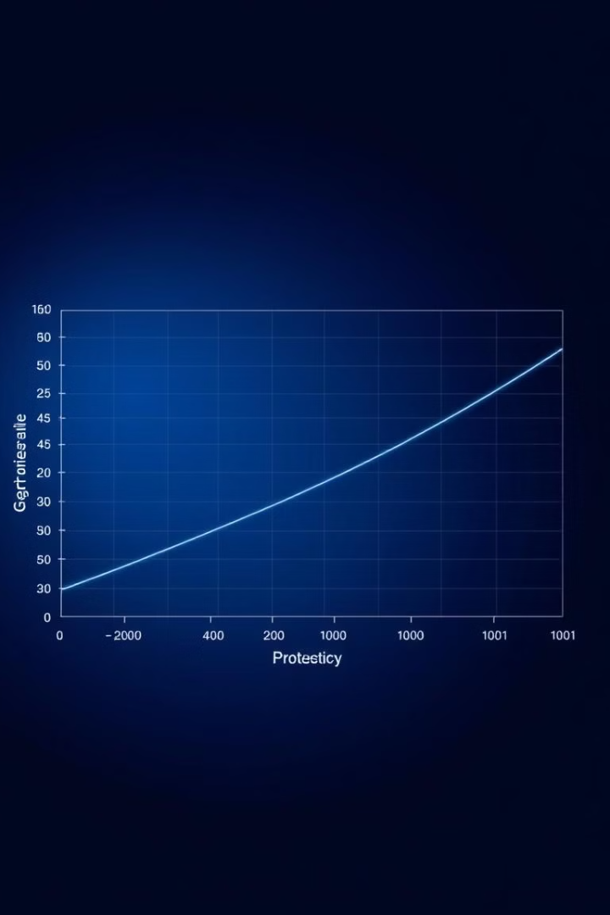
Future Work
We saw how the embedding (x + Node2Vec) performed the best consistently. This was possibly due to the different properties of atoms it was capable of encoding in a molecule. As an inspiration from this, we must try to include more aspects of molecules such as it’s 3D structure, optical activity etc. into our model.
The GNN architectures might be modified as per the specific use of this problem statement, so that it is able to achieve better classification results.
Finally, as Clintox dataset is an unbalanced dataset, so we must try to take it into account. Techniques such as SMOTE etc. can’t be applied here as a single molecule is represented by a matrix, not a vector. Specific methods might be developed to tackle this challenge.

Slide 36
Thank You

